Slide 1
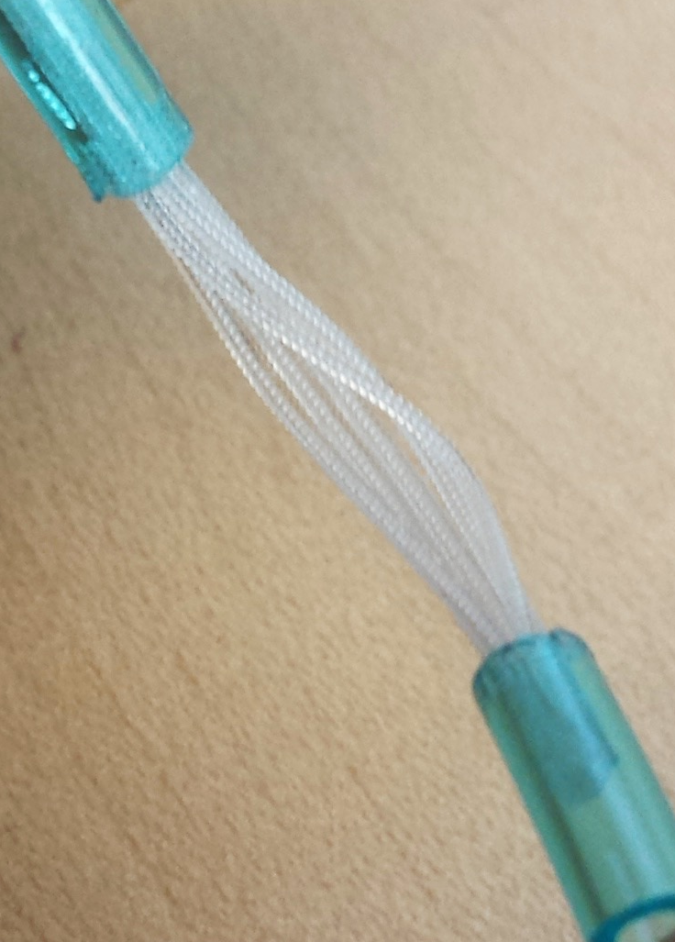
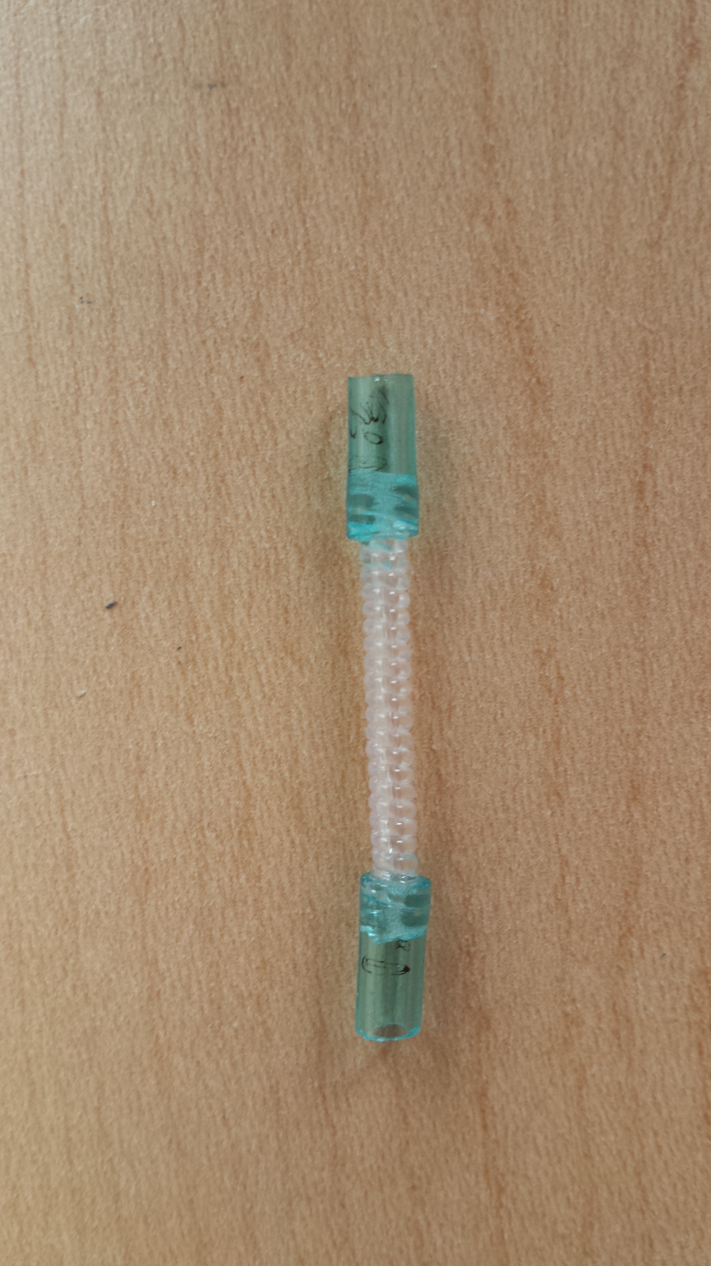
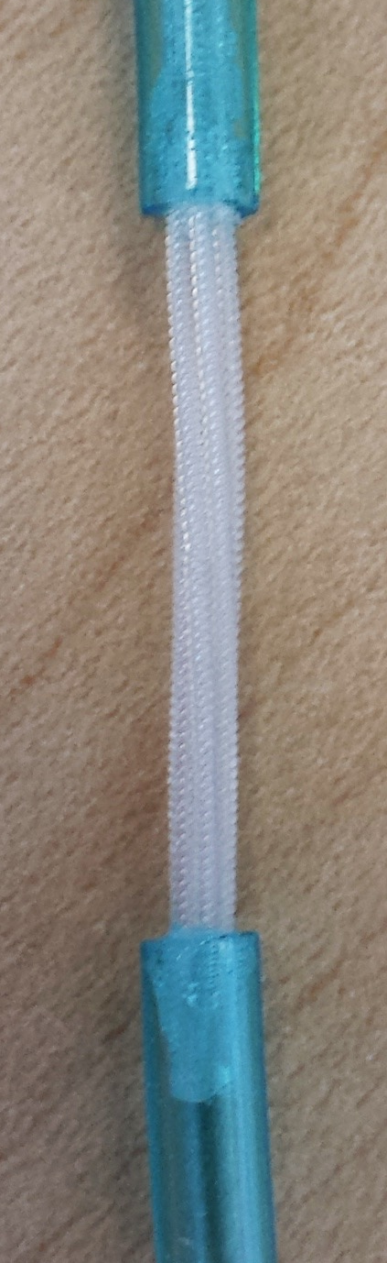

Slide 2
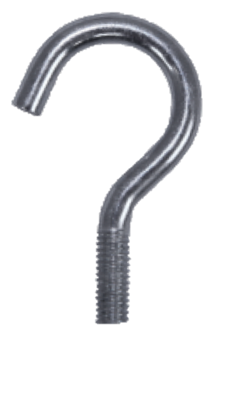

`
NiCr Heating Core
`
Applied fabrication load
Precursor Fibers
`
Moves forward during twisting

Slide 3
Laser vibrometer
Thermocouple
Torque Spool (6mm dia.)
Clamp
Bearing pair
Test sample
1.9 cm
Hot air blown over sample
Frame
Weight

Slide 4
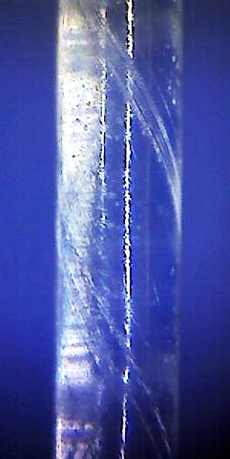
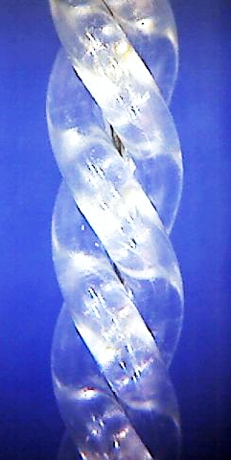
30°
30°
1 mm
1 mm

Slide 5
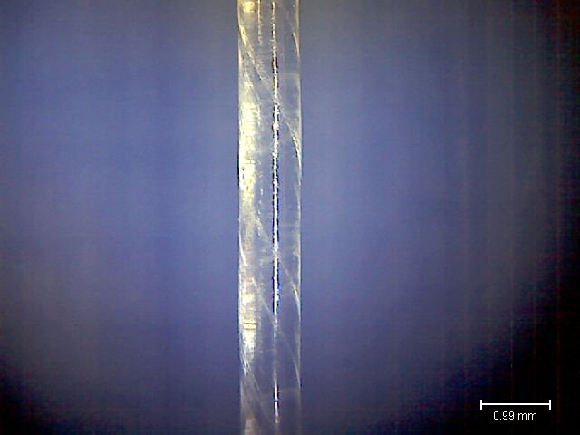

Slide 6
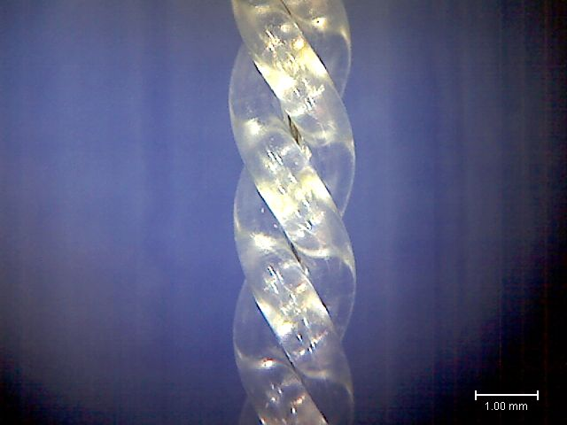

Slide 7
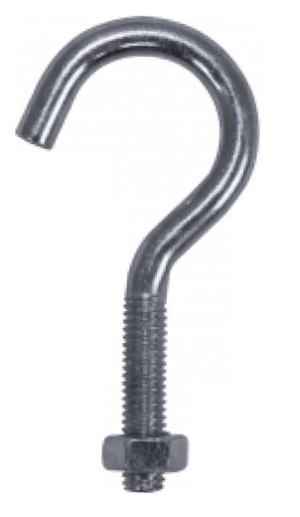

Slide 9
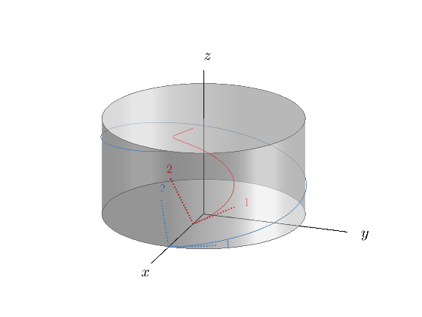
Precursor Fiber
Twist under tensile load. Thermally anneal.
Twist under tensile load until coiled to helix. Thermally anneal.
Straight-twisted polymer actuator (STPA)
Twisted-coiled Polymer Actuator (TCPA)
Reference line
Torsional deformation
ΔT
ΔT
Actuation
Actuation
Iso-view showing radially varying polymer chain pitch for TPAs
Contraction

Slide 10
Fabrication process
Actuation for each configuration
ΔT
Precursor Fiber
(monofilament)
Twist under tensile load. Thermally anneal.
High stiffness polymer chain now wraps around larger circumference causing shear stress and deformation due to low shear stiffness.
Straight-twisted polymer actuator (STPA)
ΔT
Reference line
Twist under tensile load until coiled to helix. Thermally anneal.
Torsional response of STPA translates to contraction of TCPA.
ΔT
Twisted-coiled Polymer Actuator (TCPA)
Contraction

Slide 11
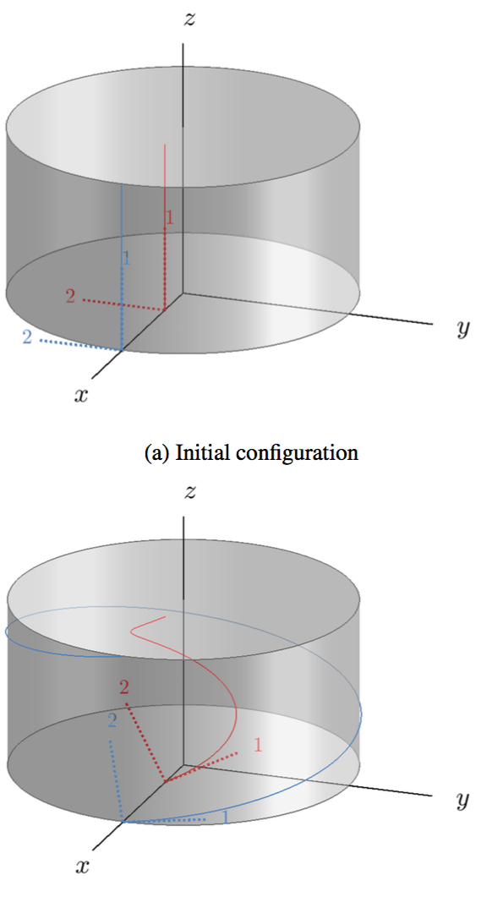

Slide 12
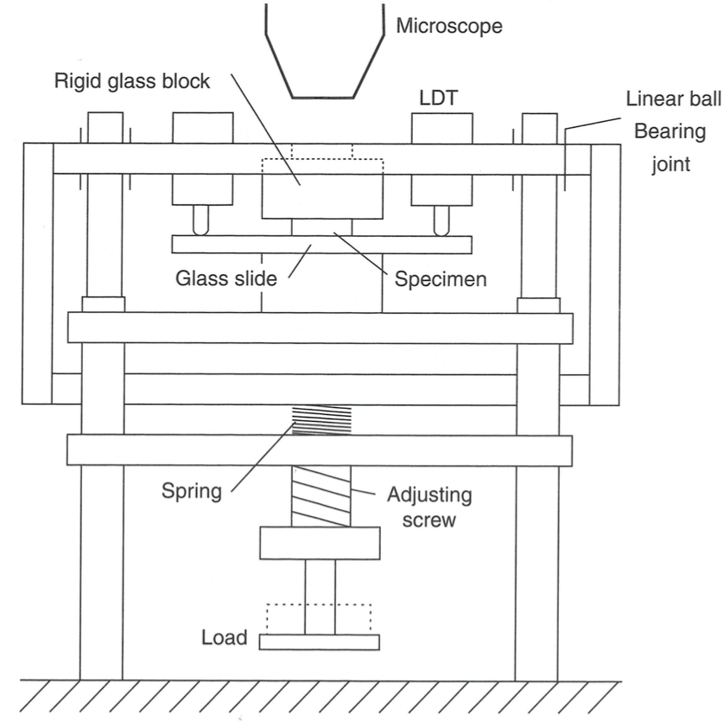
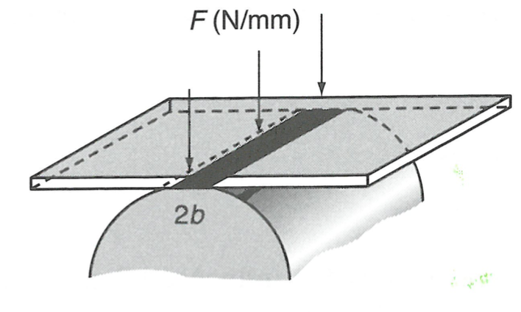

Slide 13
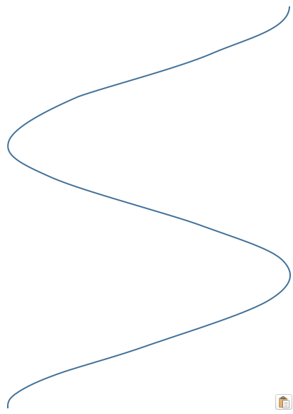

Slide 15
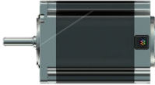
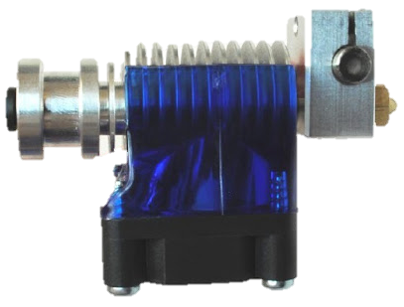
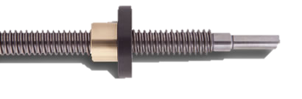
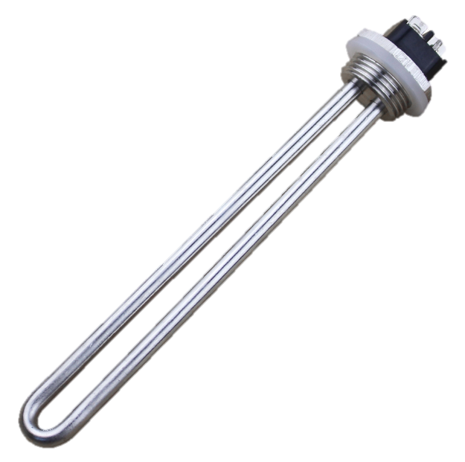
Material extrusion head
Thermally controlled environment
Twisting motor
Filament spool or particle hopper
Drawing motor
Thermal control element

